Slide 1
30 May 2023
Influence of on sales
FS2023: 63091 Social Media Analytics
CARONI Sophie / CAZZATO Emmanuel / NATER Quentin

Slide 2


content
Network source
Data loading
Pre-processing
Data quality
Community detection
Evaluation of the detection
exploration
Visualization
Persistence
Enrichment
Results

Slide 3




network Source and idea
719,150 nodes
Demonstrate if central nodes of communities are in the top rank sales
1’788’712 edges
Notes:
Creating a C project from scratch.
Working with C language concepts. (Arrays, Pointers, Data Structures).
Incorporating resources from the internet.
Autonomously figuring out how to compile C code to different targets (microprocessor ESP8266 and TVOC/eCO2 Gas Sensor Unit (SGP30)). Get the values.
Runnable code, including testing scripts provided on GitLab with working automated build scripts (Gitlab CI).

Slide 4




Data loading
Amazon Standard Identification Number
List of similar products
Notes:
Creating a C project from scratch.
Working with C language concepts. (Arrays, Pointers, Data Structures).
Incorporating resources from the internet.
Autonomously figuring out how to compile C code to different targets (microprocessor ESP8266 and TVOC/eCO2 Gas Sensor Unit (SGP30)). Get the values.
Runnable code, including testing scripts provided on GitLab with working automated build scripts (Gitlab CI).

Slide 5

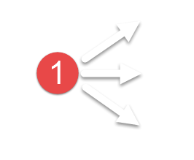
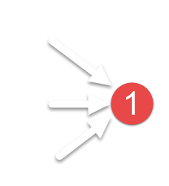
Pre-processing
While size reached
While size reached
If graph is changing
Remove isolated nodes
Remove not in-edged nodes
Remove not out-edged nodes
else
Remove the less degree nodes
Notes:
Creating a C project from scratch.
Working with C language concepts. (Arrays, Pointers, Data Structures).
Incorporating resources from the internet.
Autonomously figuring out how to compile C code to different targets (microprocessor ESP8266 and TVOC/eCO2 Gas Sensor Unit (SGP30)). Get the values.
Runnable code, including testing scripts provided on GitLab with working automated build scripts (Gitlab CI).

Slide 6
Data quality - sampling
The quality of the graph samples
Datasets | Nodes | Edges | Runtime | Clustering Coefficient | Average Degree
amazon-meta.txt | 719'150 | 1'788'712 | 0:20.95 | 0.174 | 4.974
dataset_off_amazon_enrichment.txt | 189'825 | 613'464 | 0:03.69 | 0.333 | 6.463
dataset_off_amazon_big.txt | 126'981 | 527'243 | 0:02.31 | 0.495 | 8.304
dataset_off_amazon_small.txt | 60'707 | 260'472 | 0:01.22 | 0.562 | 8.581
Notes:
Creating a C project from scratch.
Working with C language concepts. (Arrays, Pointers, Data Structures).
Incorporating resources from the internet.
Autonomously figuring out how to compile C code to different targets (microprocessor ESP8266 and TVOC/eCO2 Gas Sensor Unit (SGP30)). Get the values.
Runnable code, including testing scripts provided on GitLab with working automated build scripts (Gitlab CI).

Slide 7
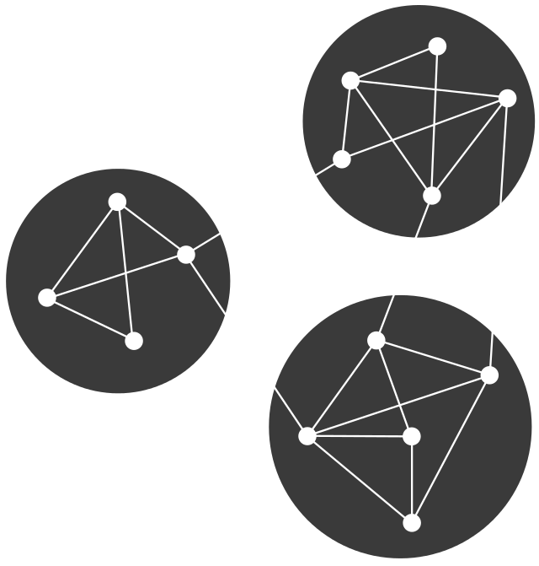

Network exploration
Connected ? Homogenous ?
DFS
Efficiently explores interconnected books
Memory-efficient by fetching details on-the-fly
Potential to discover hidden relationships
A*
Guarantees optimal solutions
Utilizes heuristic evaluation for efficient exploration
Prioritizes promising paths
Notes:
Creating a C project from scratch.
Working with C language concepts. (Arrays, Pointers, Data Structures).
Incorporating resources from the internet.
Autonomously figuring out how to compile C code to different targets (microprocessor ESP8266 and TVOC/eCO2 Gas Sensor Unit (SGP30)). Get the values.
Runnable code, including testing scripts provided on GitLab with working automated build scripts (Gitlab CI).

Slide 8
Network visualization
Clear and easy view of:
Whole graph with communities in colours and central nodes in gold
Degree Distribution of the while graph
Single community
Notes:
Creating a C project from scratch.
Working with C language concepts. (Arrays, Pointers, Data Structures).
Incorporating resources from the internet.
Autonomously figuring out how to compile C code to different targets (microprocessor ESP8266 and TVOC/eCO2 Gas Sensor Unit (SGP30)). Get the values.
Runnable code, including testing scripts provided on GitLab with working automated build scripts (Gitlab CI).

Slide 9
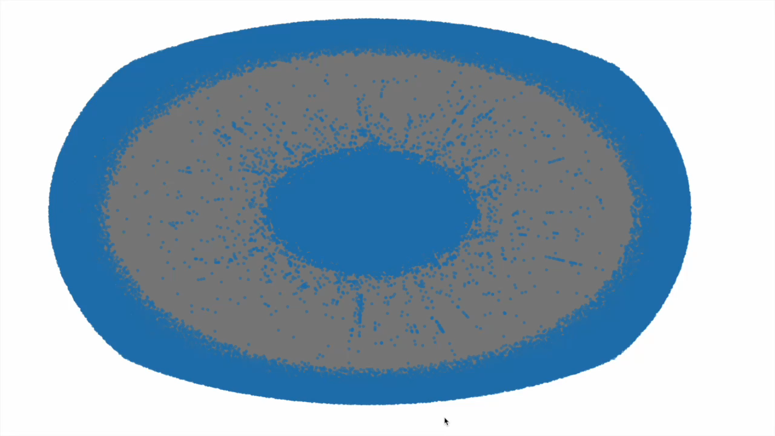

Network visualization
Time to display
Notes:
Creating a C project from scratch.
Working with C language concepts. (Arrays, Pointers, Data Structures).
Incorporating resources from the internet.
Autonomously figuring out how to compile C code to different targets (microprocessor ESP8266 and TVOC/eCO2 Gas Sensor Unit (SGP30)). Get the values.
Runnable code, including testing scripts provided on GitLab with working automated build scripts (Gitlab CI).

Slide 10
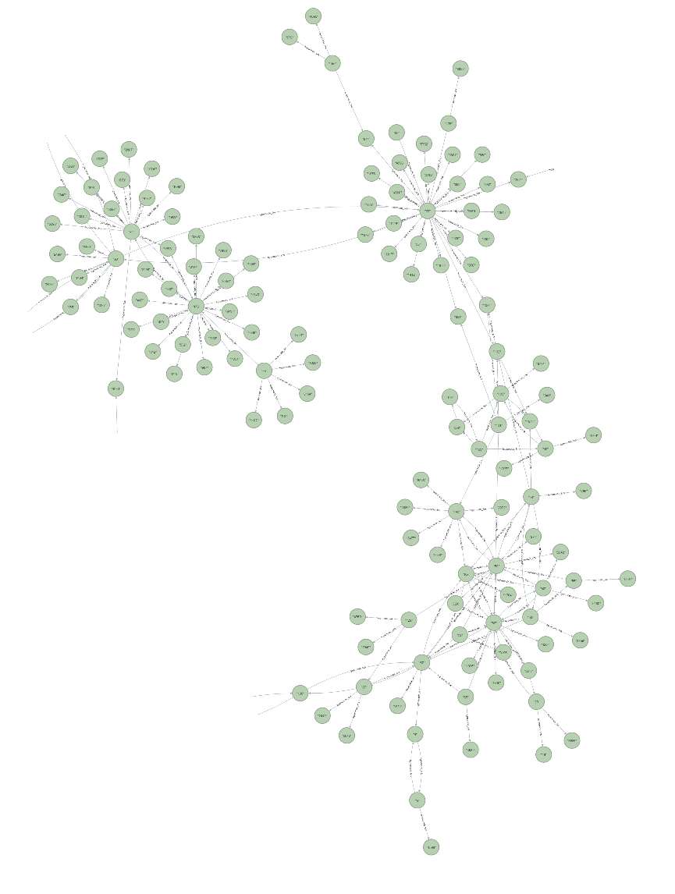
Graph persistence
Fast queries
Saved/Store
https://workspace-preview.neo4j.io/workspace/query
Notes:
Creating a C project from scratch.
Working with C language concepts. (Arrays, Pointers, Data Structures).
Incorporating resources from the internet.
Autonomously figuring out how to compile C code to different targets (microprocessor ESP8266 and TVOC/eCO2 Gas Sensor Unit (SGP30)). Get the values.
Runnable code, including testing scripts provided on GitLab with working automated build scripts (Gitlab CI).

Slide 11
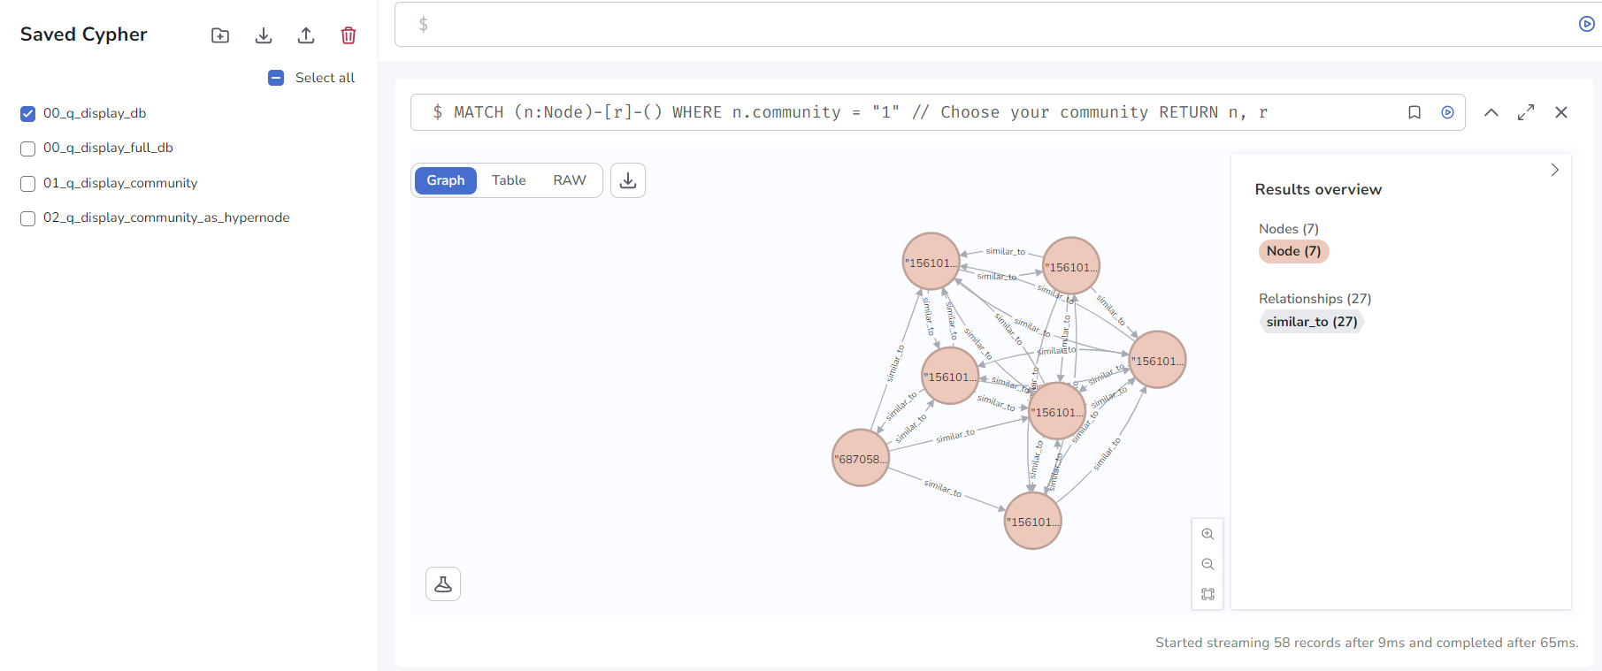
Graph persistence
https://workspace-preview.neo4j.io/workspace/query
Notes:
Creating a C project from scratch.
Working with C language concepts. (Arrays, Pointers, Data Structures).
Incorporating resources from the internet.
Autonomously figuring out how to compile C code to different targets (microprocessor ESP8266 and TVOC/eCO2 Gas Sensor Unit (SGP30)). Get the values.
Runnable code, including testing scripts provided on GitLab with working automated build scripts (Gitlab CI).

Slide 12
Data enrichment
Find similar ASIN
Compute a merge
Have a better silhouette score
Take the better sampling
Notes:
Creating a C project from scratch.
Working with C language concepts. (Arrays, Pointers, Data Structures).
Incorporating resources from the internet.
Autonomously figuring out how to compile C code to different targets (microprocessor ESP8266 and TVOC/eCO2 Gas Sensor Unit (SGP30)). Get the values.
Runnable code, including testing scripts provided on GitLab with working automated build scripts (Gitlab CI).

Slide 13
Community detection – Which Algo
Comparison of algorithms
datasets | Algorithm | Runtime | Silhouette Index | Communities
dataset_off_amazon_big.txt | Louvain
dataset_off_amazon_big.txt | Girvan Newman
dataset_off_amazon_big.txt | Modularity
Notes:
Creating a C project from scratch.
Working with C language concepts. (Arrays, Pointers, Data Structures).
Incorporating resources from the internet.
Autonomously figuring out how to compile C code to different targets (microprocessor ESP8266 and TVOC/eCO2 Gas Sensor Unit (SGP30)). Get the values.
Runnable code, including testing scripts provided on GitLab with working automated build scripts (Gitlab CI).

Slide 14




Community detection
Result
Runtime
New modality
Weight directed
https://iopscience.iop.org/article/10.1088/1742-5468/2008/10/P10008/pdf
Notes:
Creating a C project from scratch.
Working with C language concepts. (Arrays, Pointers, Data Structures).
Incorporating resources from the internet.
Autonomously figuring out how to compile C code to different targets (microprocessor ESP8266 and TVOC/eCO2 Gas Sensor Unit (SGP30)). Get the values.
Runnable code, including testing scripts provided on GitLab with working automated build scripts (Gitlab CI).

Slide 15
Evaluation of the community detection
The quality of the community detection
Algorithms | Datasets | Runtime | Silhouette Idx | Accuracy | Precision | Recall | Jaccard | Communities
Simple Detection (homemade) | amazon_big
Simple Detection (homemade) | amazon_enrichment
Amazon Detection (homemade) | amazon_big | 0:00:12.8 | 0.05008 | 97.01% | 95.36% | 97.01% | 0.925 | 21157
Amazon Detection (homemade) | amazon_ enrichment | 0:00:17.5 | 0.19851 | 97.54% | 89.76% | 97.54% | 0.875 | 17818
NetworkX Louvain | amazon_big | 0:00:21.4 | 0.02363 | - | - | - | - | 23521
NetworkX Louvain | amazon_enrichment | 0:00:17.7 | 0.08338 | - | - | - | - | 26887
Notes:
Creating a C project from scratch.
Working with C language concepts. (Arrays, Pointers, Data Structures).
Incorporating resources from the internet.
Autonomously figuring out how to compile C code to different targets (microprocessor ESP8266 and TVOC/eCO2 Gas Sensor Unit (SGP30)). Get the values.
Runnable code, including testing scripts provided on GitLab with working automated build scripts (Gitlab CI).

Slide 16

DEMOnstration
Notes:
Creating a C project from scratch.
Working with C language concepts. (Arrays, Pointers, Data Structures).
Incorporating resources from the internet.
Autonomously figuring out how to compile C code to different targets (microprocessor ESP8266 and TVOC/eCO2 Gas Sensor Unit (SGP30)). Get the values.
Runnable code, including testing scripts provided on GitLab with working automated build scripts (Gitlab CI).

Slide 17
Conclusion - Technical
Easy to load and the sample
Better Community Detection Algorithm
Dataset enriched
Graph can be visualized and is store
Notes:
Creating a C project from scratch.
Working with C language concepts. (Arrays, Pointers, Data Structures).
Incorporating resources from the internet.
Autonomously figuring out how to compile C code to different targets (microprocessor ESP8266 and TVOC/eCO2 Gas Sensor Unit (SGP30)). Get the values.
Runnable code, including testing scripts provided on GitLab with working automated build scripts (Gitlab CI).

Slide 18
Conclusion - Business
Better popular nodes of each community correspond to better sale ranks
Overall center of communities doesn't display the sale ranks
Amazon dataset can be analysed
Notes:
Creating a C project from scratch.
Working with C language concepts. (Arrays, Pointers, Data Structures).
Incorporating resources from the internet.
Autonomously figuring out how to compile C code to different targets (microprocessor ESP8266 and TVOC/eCO2 Gas Sensor Unit (SGP30)). Get the values.
Runnable code, including testing scripts provided on GitLab with working automated build scripts (Gitlab CI).

Slide 19
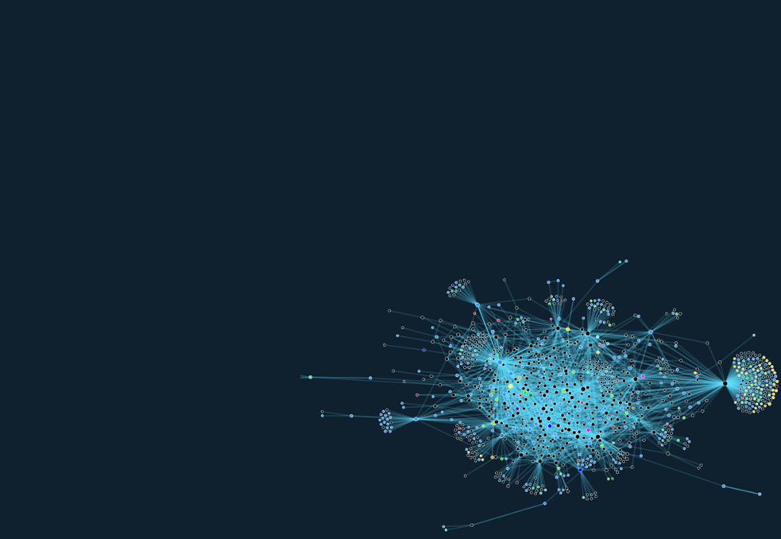

questions
Notes:
Creating a C project from scratch.
Working with C language concepts. (Arrays, Pointers, Data Structures).
Incorporating resources from the internet.
Autonomously figuring out how to compile C code to different targets (microprocessor ESP8266 and TVOC/eCO2 Gas Sensor Unit (SGP30)). Get the values.
Runnable code, including testing scripts provided on GitLab with working automated build scripts (Gitlab CI).

